Slide 1
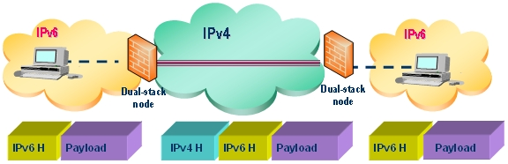
Domain Name System. IPv6
Module 4
SoftUni Team
Technical Trainers
Software University
http://softuni.bg

Slide 2
Questions
sli.do #NetAdvanced

Slide 3
Table of Contents
Domain Name System
IPv6
Demonstration

Slide 4
Domain Name System

Slide 5
DNS structure
DNS is hierarchical and distributed system
At the top there is the root domain or “.”
One level below are the TLD (top level domains, i.e. “.com”)
One level below are the second level domains, i.e. “yahoo”
Possible third level domains, etc.
DNS Zone – part of the DNS namespace, managed by specific organization

Slide 6
Resource records (in a DNS zone)
Common resource records and their purposes:
A record: a name which points to a IPv4 address
AAAA record: a name which points to a IPv6 address
CNAME record (alias): a name which points to another name (Canonical Name)
MX record: shows who is the mail server for that domain (Mail EXchanger)
TXT record: text entry, usually used for domain verification and anti-spam (TeXT)
NS record: shows which are the name servers for the zone (Name Server)
SOA record: contains administrative information about the zone (Start Of Authority)

Slide 7
DNS end to end process
First, the client checks its local cache
If the entry is not in the cache, the client makes a query to the first DNS server(s) in its local configuration
The client will query alternative (second) DNS server only if the first one is not reachable (and not if it receives a negative answer)
The DNS server checks its local cache
If the entry is not in the cache, the DNS server queries a forwarder
If no forwarder available, the DNS server uses the Root Hints

Slide 8
Windows client local DNS cache
Resolved DNS queries stay in the local cache for a time period determined by the zone TTL value on the server
The hosts file
Alternative name resolution mechanism
Usually located in %systemroot%\system32\drivers\etc folder
Not distributed and scalable but can serve as a backup DNS method
It has higher priority than DNS resolution
The content of the hosts file is constantly copied in the DNS cache

Slide 9
Windows client local DNS cache (2)
ipconfig /displaydns
shows the local DNS cache of a Windows computer
ipconfig /flushdns
deletes the local DNS cache of a Windows computer
Remember – the hosts file content is constantly copied in this cache

Slide 10
Recursive and iterative queries
Recursive query - the DNS server must respond with either
the requested resource
OR
Error message (not found)
Iterative query - the DNS server responds with the best answer it can give

Slide 11
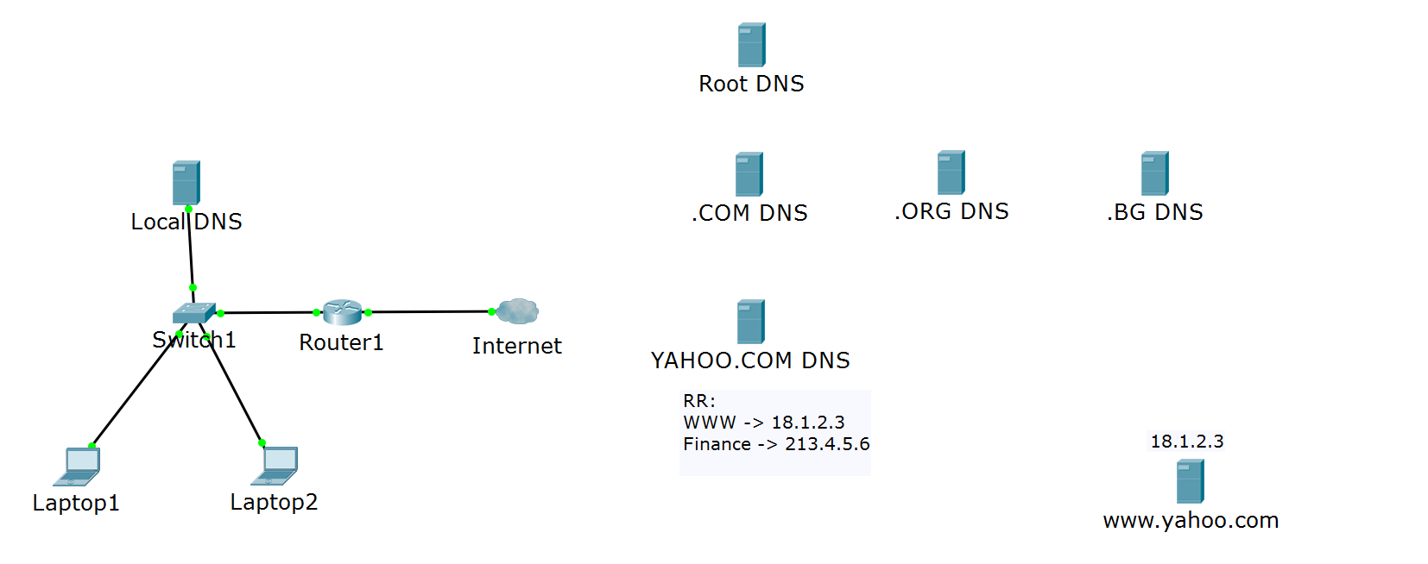


DNS query process
Where is www.yahoo.com?
I can only tell you where is .COM
Where is www.yahoo.com?
I can tell you only where is YAHOO.COM
It is at 18.1.2.3!
Where is www.yahoo.com?
Where is www.yahoo.com?
It is at 18.1.2.3!
https://www.yahoo.com

Slide 12
The NSLOOKUP command
To check a DNS resolution, one can use ping or nslookup
ping - intuitive to use but can have older and inaccurate info the purpose of ping is not to troubleshoot DNS
nslookup - useful tool designed for troubleshooting DNS
Demo: how to use nslookup on Windows

Slide 13
IPv6

Slide 14
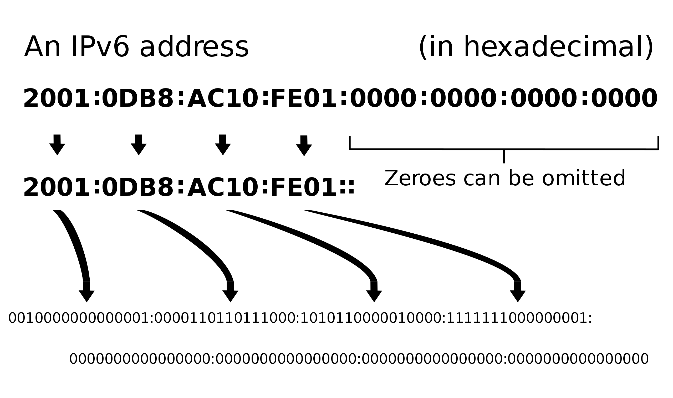
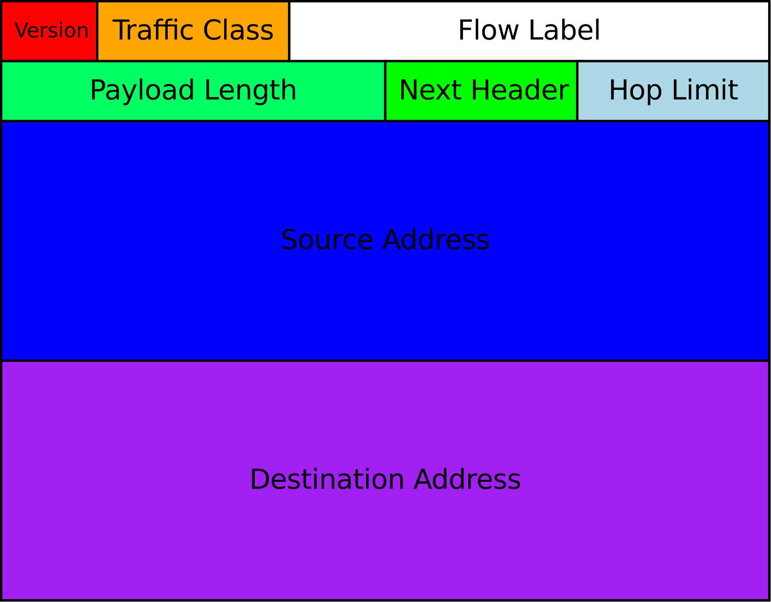
IPv6 introduction
Larger address space (128 bits rather than 32) or 2¹²⁸
Simplified header format
Improved quality of service and security

Slide 15
How big is the IPv6 address space?
2¹²⁸ is like 3.4×10³⁸ , which is: 340,282,366,920,938,463,463,374,607,431,768,211,456
It is 10 million trillion times the total number of grains of sand on all the beaches in the world
We can assign IPv6 address to every atom on the surface of the Earth, and still have enough addresses left to do another 100+ earths

Slide 16
IPv6 address format
IPv6 address is represented as eight groups of four hexadecimal digits
Example:
2001:0db8:0000:0000:0000:ff00:0042:832
Each of this groups has 16 bits and is separated from the others with “:”

Slide 17
Abbreviations
First - remove the long string with zeros (allowed only once)
Original: 2041:0000:140F:0000:0000:0000:875B:131B
Short: 2041:0000:140F::875B:131B
Second - replace four zeros with one
Short: 2041:0000:140F::875B:131B
Shorter: 2041:0:140F::875B:131B
The result from both: 2041:0000:140F:0000:0000:0000:875B:131B -> 2041:0:140F::875B:131B

Slide 18

IPv6 prefixes
2001:1234:5678:1234:5678:ABCD:EF12:1234/64

Slide 19
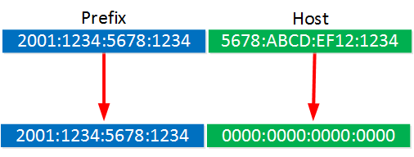
IPv6 prefixes (2)
2001:1234:5678:1234:0000:0000:0000:0000/64
2001:1234:5678:1234::/64

Slide 20
IPv6 address types
Unicast - a packet is delivered to one interface
Multicast - a packet is delivered to multiple interfaces
Anycast - a packet is delivered to the nearest of multiple interfaces (as defined by the routing protocols in use)
*no more Broadcast in IPv6

Slide 21
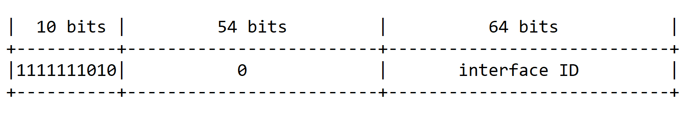
IPv6 scopes
Link-local (similar to APIPA in IPv4)
Prefix is FE80::/64
Global (similar to IPv4 public addresses)
Typical prefix is 2000::/3
…or FE80::/10?
::1/128 - the loopback address is a unicast localhost address

Slide 22
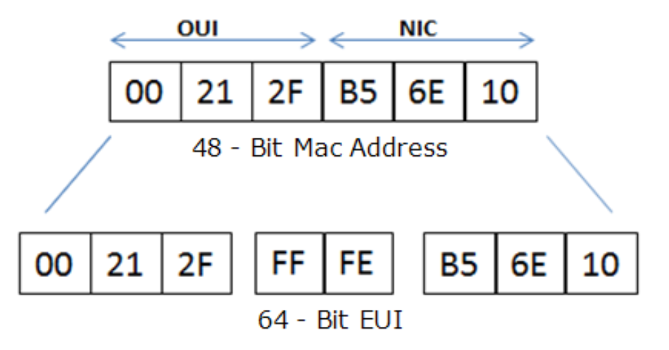
IPv6 EUI-64 bit address
EUI - Extended Unique Identifier
One option to auto-assign the second 64 bits to a link-local address using the MAC address of the interface

Slide 23
IPv6 tunneling
Encapsulates IPv6 packets in IPv4 packets for delivery across an IPv4 infrastructure
Different methods exist – 6to4, 6rd, Teredo, ISATAP, etc.

Slide 24
Demonstration

Slide 25

Summary
Domain Name System
IPv6
Demonstration
…
…
…

Slide 27






СофтУни диамантени партньори

Slide 28






СофтУни диамантени партньори

Slide 29





Trainings @ Software University (SoftUni)
Software University – High-Quality Education, Profession and Job for Software Developers
softuni.bg
Software University Foundation
http://softuni.foundation/
Software University @ Facebook
facebook.com/SoftwareUniversity
Software University Forums
forum.softuni.bg

